Slide 1
The RIBBS Replacement – A Review
Steve W. Smith, Base 60 Consulting
Greater Boston Postal Customer Council
Harvard University Mail and Distribution Facility
February 15, 2018

Slide 2
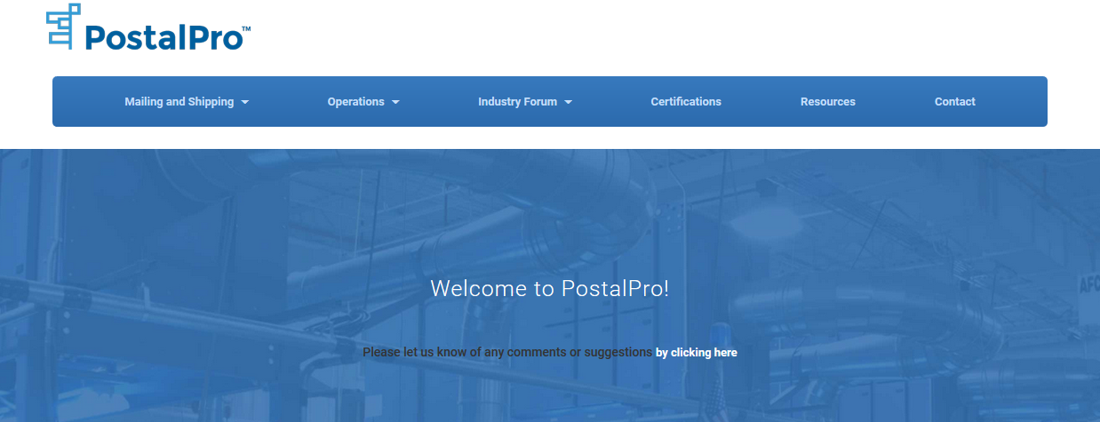
Notes:
Introduction - History of RIBBS, Why Redesign, Redesign Approach, Introduction to PostalPro.
The PostalPro home page displays the primary index options for ease of selection.
On the top and bottom of the landing page is a Comments and Suggestions entry. USPS Headquarters is actively soliciting any improvements from the industry.

Slide 3
History of RIBBS
Established in late 1980s as dial-up modem bulletin board Channel for Address Mgmt. to communicate with software dev. industry
Trustworthy place for mail service providers to access current document requirements
RIBBS even sold advertising, allowing service providers to pay for value-added content and links.
As technology evolved and the internet was introduced, there was also an opportunity for RIBBS to evolve.
Notes:
RIBBS provided a transition of electronic presentation in one place. This would eventually spread to other stand-alone sites like PostalExplorer.

Slide 4
History of RIBBS
In 2002/2003, Address Management came under the umbrella of Intelligent Mail and Address Quality.
Mail Entry & Payment Technology was looking for a vehicle to disseminate information rapidly to commercial mailers
Other USPS stakeholders saw opportunity to leverage RIBBS, such as Operations, Customer & Industry Affairs, etc.
Notes:
With the addition of Address Management and Mail Entry & Payment Technology, other USPS stakeholders found more use for RIBBS.

Slide 5
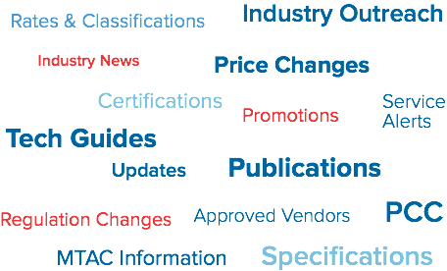
Mailing Industry Channel:
Contextual, procedural and news-worthy information for commercial mailers and software solutions providers
Content Found on RIBBS Today
Notes:
The current components of RIBBS includes the most commonly accessed information segments. All of these are populated in the PostalPro offering.

Slide 6
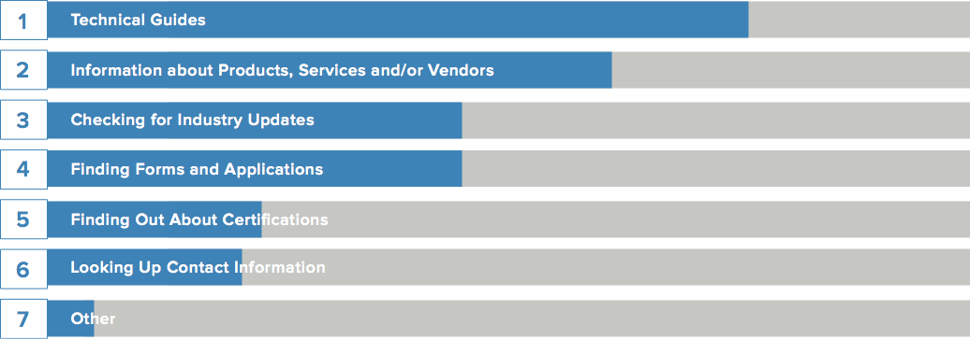
What Typically Brings you to RIBBS?
How Frequently Do You Visit RIBBS?
Notes:
The USPS Headquarters team assembled focus groups to survey the types of lookups and frequency of visits.
Technical Guides, in first position, is an interesting note on how the industry relies on the USPS to provide a consistent resource.

Slide 7
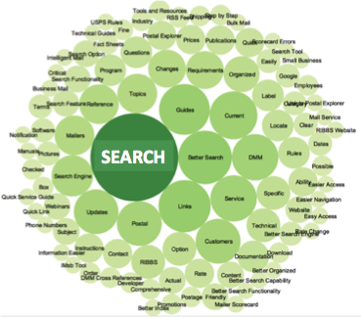
RIBBS User Survey Results
Limited search functionality
Confusion in version control
Not user friendly; information is difficult to locate
Difficult to navigate, cluttered, redundant
“RIBBS has served a good purpose, but it has outgrown itself.”
- Beta Tester
Notes:
The RIBBS User Survey isolated the top complaints about the RIBBS structure. The PostalPro development team is now comparing what is improved in the transition from RIBBS to PostalPro.

Slide 8
Why Redesign?
Increasingly Difficult to Find Information
Users increasingly frustrated with search
Amount of content is overwhelming
Website’s design feels outdated when compared to other USPS interactive sites
RIBBS is Not Section 508 Compliant
All users, regardless of disability status, can access technology
Text equivalent for all non-text elements
Information conveyed in color can be read without color
Need for Updated Technology for Enhanced Security
Enhanced security, performance and scalable infrastructure to accommodate future features and functionality
Notes:
The reason for RIBBS redesign covered a range of reasons including the Section 508 compliance. Enhanced security was a motivating factor to change.

Slide 9
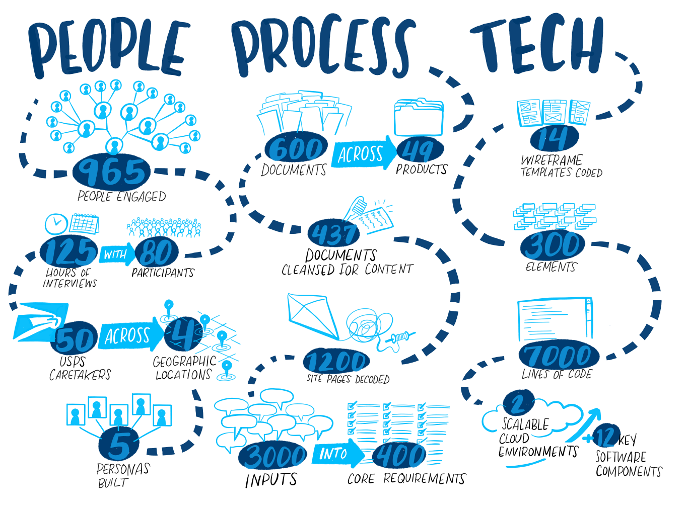
Notes:
The metrics of what it took for to reformulate PostalPro is explained in this pathways simplification.

Slide 10
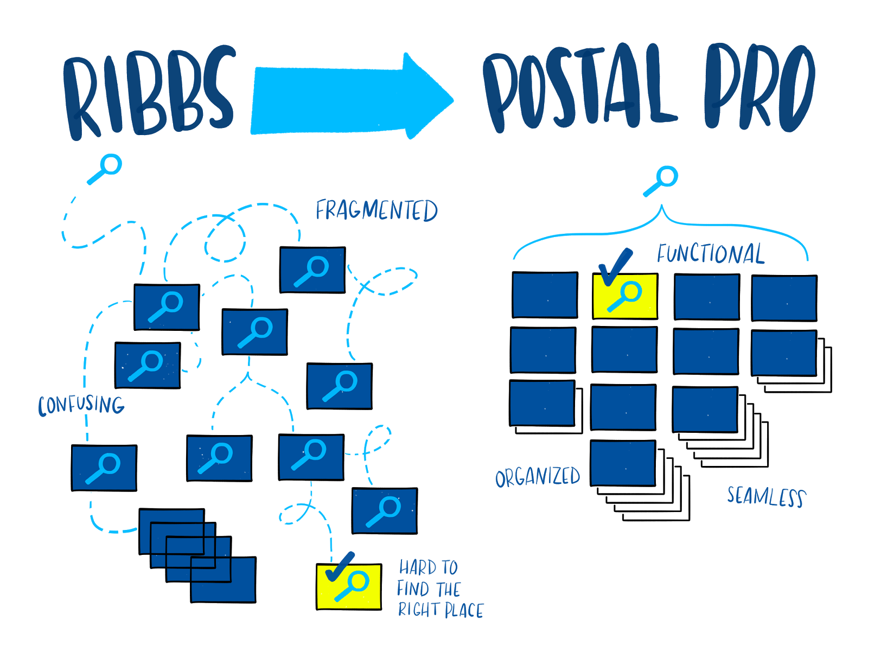
Notes:
The fragmentation comparison of RIBBS to PostalPro architecture.

Slide 11
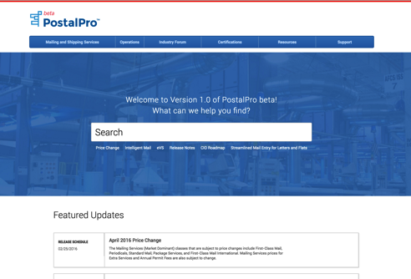
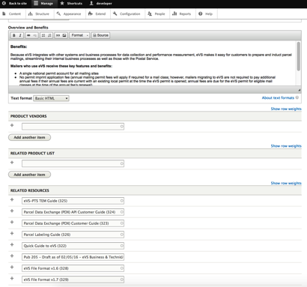
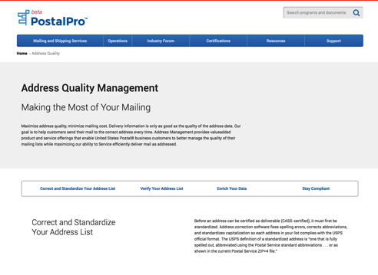
Content Management System
Stylized Page Templates (Front End)
Drupal Content Mgmt. System (Back End)
Content loaded in CMS populates stylized page templates
Loaded 2000+ pages to date
Notes:
The service basis – DRUPAL CONTENT MANAGEMENT SYSTEM, continues to support the PostalPro templates across various levels of the display.

Slide 12
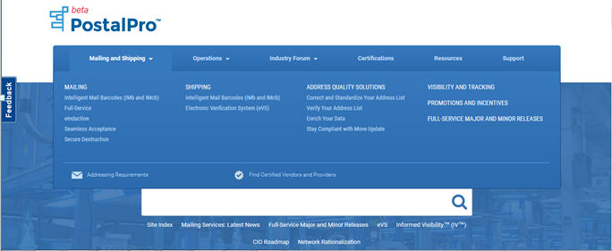
Information Available in the Mega Menu
Located on the Home Page
Notes:
Taking a look at the index drop down selections, PostalPro presents the most commonly requested topics measured from previous user activity and requests.

Slide 13
Mega Menu Selection
Notes:
The home page Mega Menu carries forward the practice of “Quick Index” look up.

Slide 14
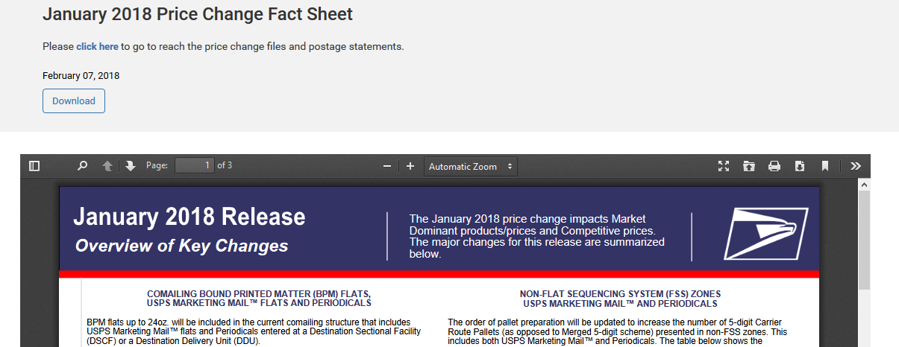
Mega Menu Selection
Notes:
Selecting “Price Change” produces a summary page of the recent Key Changes for quick reference.

Slide 15
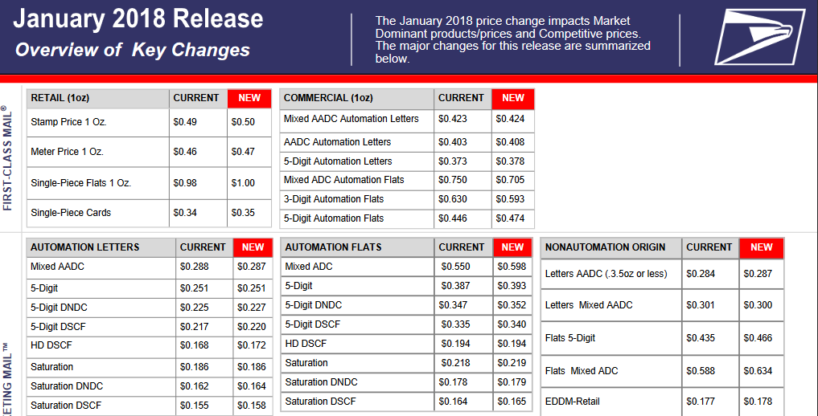
Mega Menu Selection
Notes:
Detailed view of the Key Changes page.

Slide 16
Mega Menu Selection
Notes:
Instead of the summary Key Changes page, if a spreadsheet or postage statement presentation is more useful, the PostalPro link will take the viewer to another location.

Slide 17
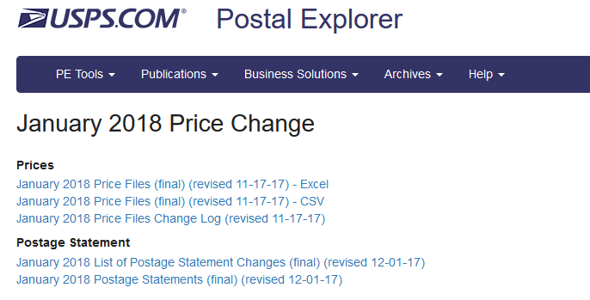
Mega Menu Selection
Notes:
Available formats allow a variety of display for internal or client audiences.

Slide 18
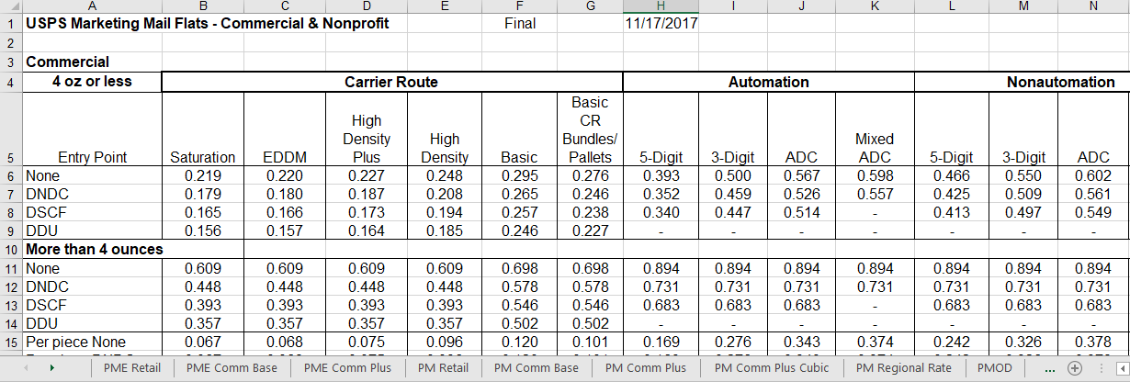
Mega Menu Selection
Notes:
The Excel version of the Postage Pricing information. Easy to export.

Slide 19
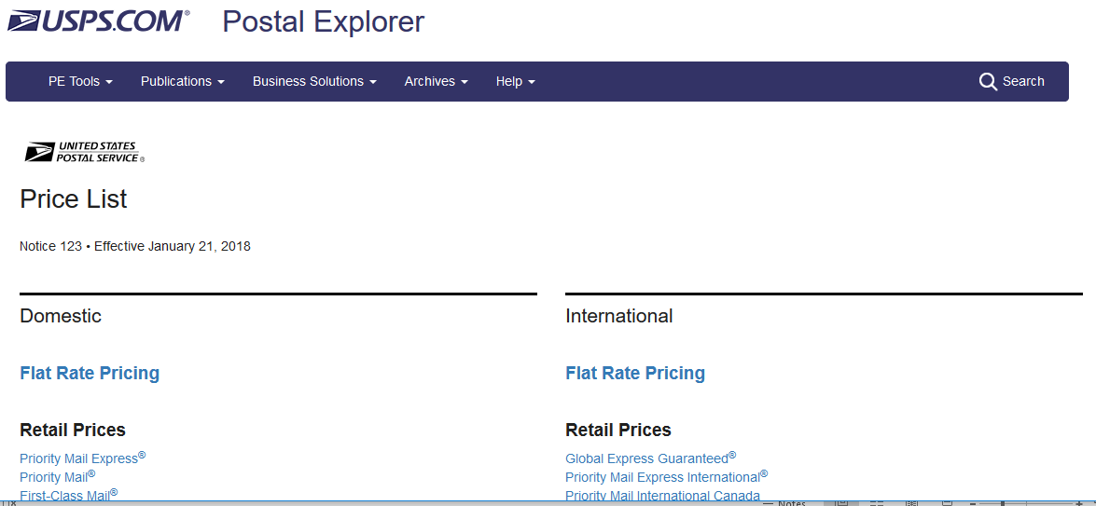
Mega Menu Selection
Notice (Pub) 123 instead of price change.
Notes:
As a general rule, if the information you need is in a publication, PostalPro will direct you to PostalExplorer. PostalExplorer is the most frequently updated source for this type of information. This is the Pricing Guide information in yet another format – Notice 123.

Slide 20
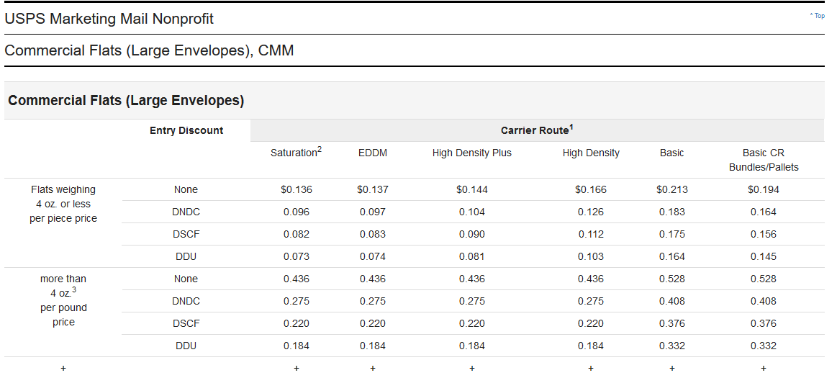
Mega Menu Selection
Notes:
The Notice 123 pricing information for the same price table seen in the Quick Guide and Excel spreadsheet versions.

Slide 21
Mega Menu Selection
Site Index organized by existing USPS descriptions.
Predictive (Intelligent) association is not active.
Notes:
The homepage Site Index is a predetermined list of subject matter. Unlike a Custom Search, the Site Index is not predictive.

Slide 22
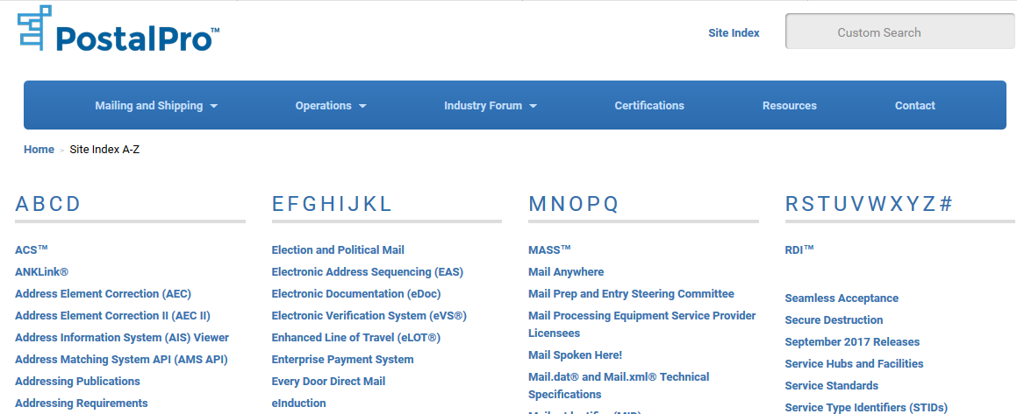
Mega Menu Selection
Notes:
The A-Z index listing requires a general idea of the title you wish to research.

Slide 23
Mega Menu Selection
Acronyms or Long Form Names
Notes:
EDDM is Every Door Direct Mail. Mail Anywhere, Pay Anywhere is only Mail Anywhere.

Slide 24
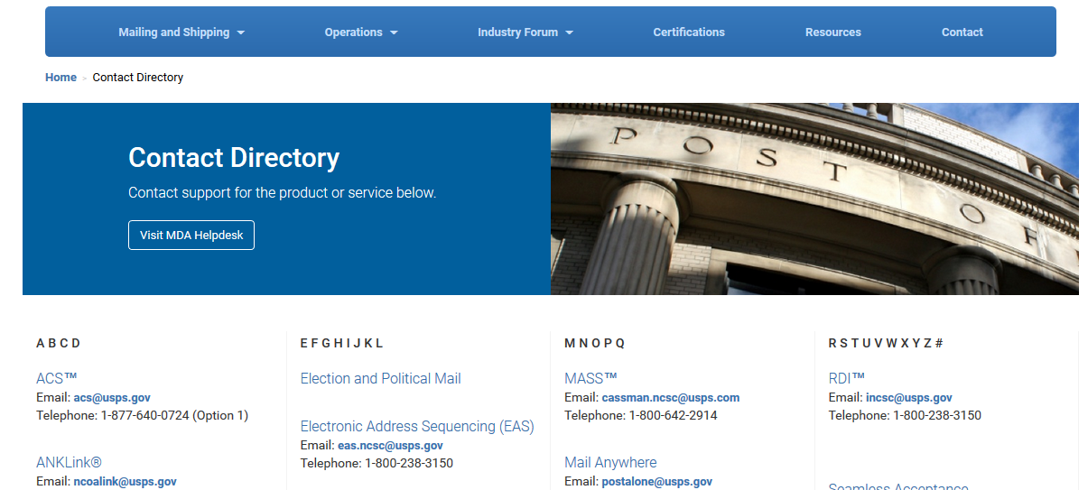
Mega Menu Selection
Notes:
On the home page, one of the best topic selections is the Contact Directory. If this listing is missing anything you need, please let the PostalPro team know.

Slide 25
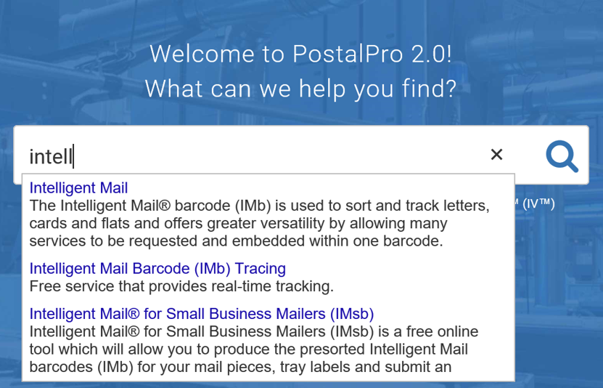
Advanced Search Functionality
Powered by Google
Weighted Results to Boost Relevancy
Keyword
& Acronym Search
Tailor
Results
FrequentUpdates
Prioritized Search Items
Notes:
Moving to Custom Search provides more predictive options.

Slide 26
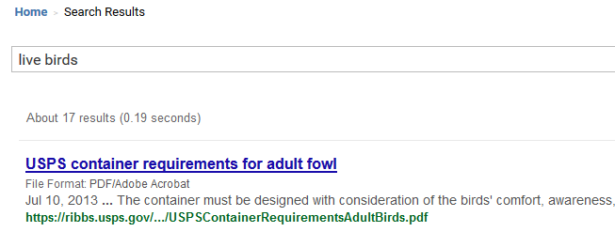
Notes:
Two examples of odd or least frequent searches produce instant results.

Slide 27
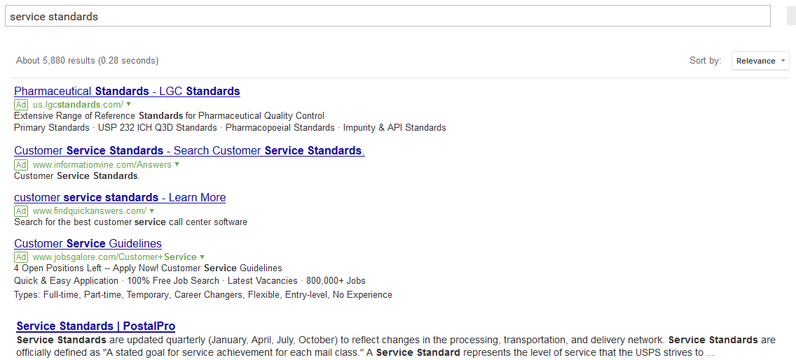
Advertisements In The Search
Notes:
Custom Search has presented advertisements in the past. The PostalPro team is working on changing this presentation.
Looking for Service Standards, PostalPro is the last in this option.

Slide 28
PostalPro Release Update – 16 February 2017
The Postal Service has resolved two issues affecting PostalPro.
The Industry Alerts and Notices page was not loading properly in many cases. This has been resolved as of February 15 and the development team is continuing to monitor the page for further speed enhancements.
The second issue involves the Google Search displaying results from third party websites. This has also been remedied and is expected to move into production on the afternoon of February 16.
Thank you for your patience in these matters and please feel free to report any further issues by clicking on the feedback link on the top or bottom of the page, by emailing the PostalPro support team at PostalProSupport@usps.gov or by calling the PostalOne! Customer Care Center at (800) 522-9085.
Notes:
PostalPro

Slide 29
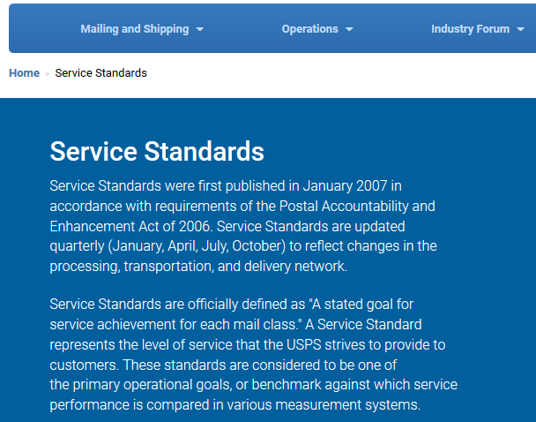
Notes:
Many of the Custom Search topics have a landing page with a definition or frequency of update section.

Slide 30
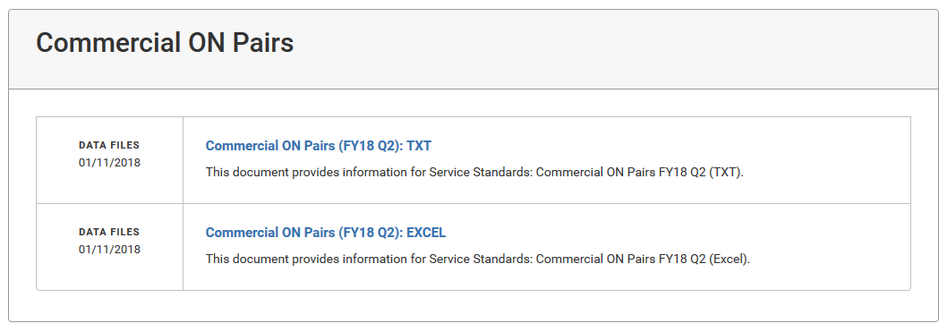
Notes:
The information in the Service Standards search is provided in subtopic table form. Again, if there is a format option, you are provided with an opportunity to select or refine the choice.

Slide 31
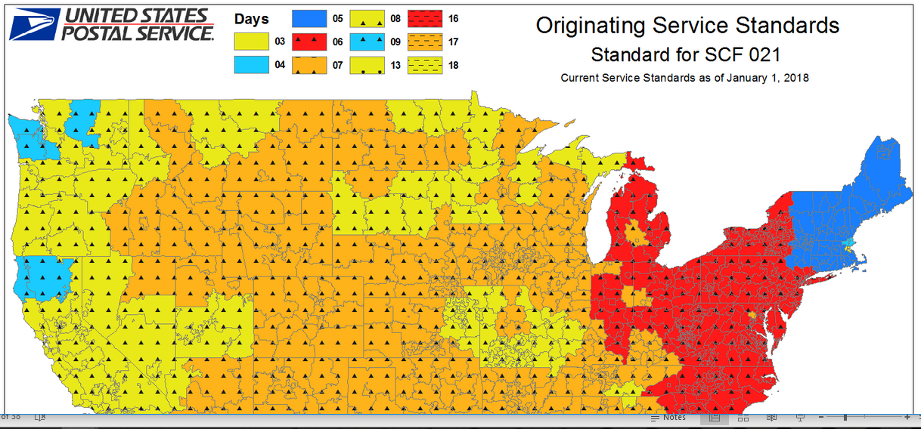
Notes:
The Service Standards map is an example of an interactive information available through the PostalPro portal.

Slide 32
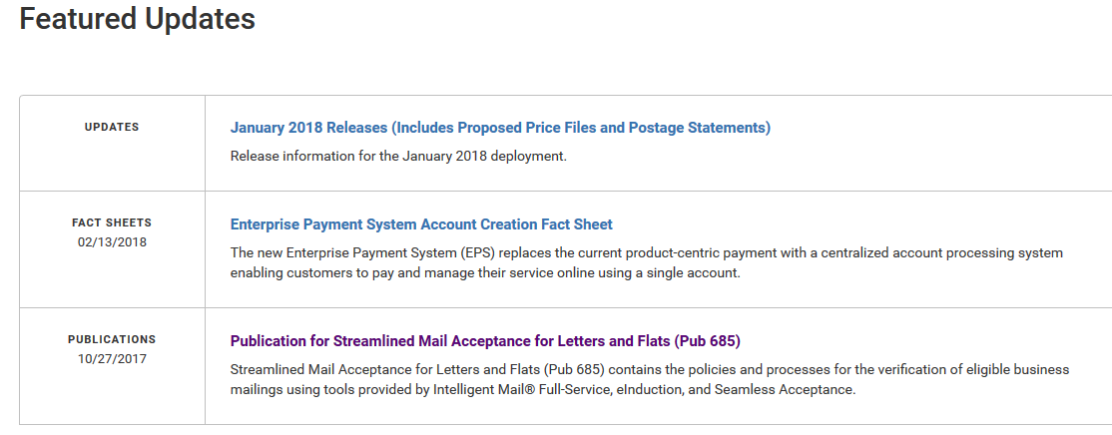
Curated Feature Resources
on the Home Page
Notes:
The PostalPro Home Page breaks out the updates in two table presentations.
Featured Updates has three categories for the user.

Slide 33
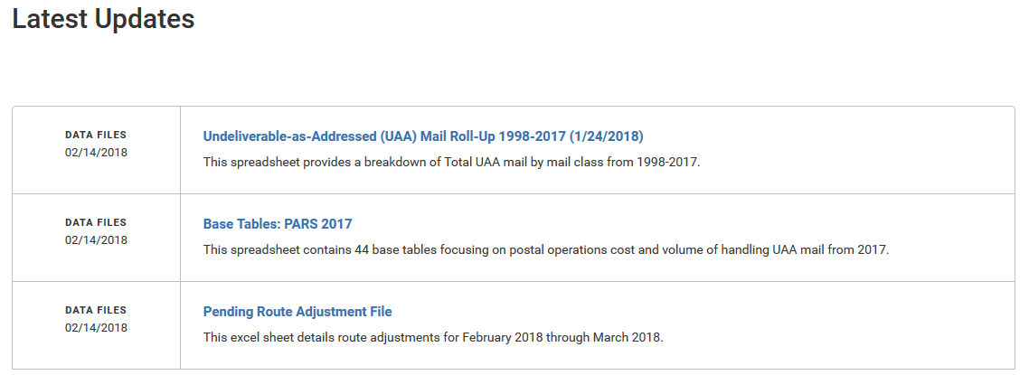
The Most Recently Added Content is
Always Shown on the Home Page
Notes:
Latest Updates on the Home Page is replaced frequently with new items.

Slide 34
Additional Resources – Home Page
Pub 32 – The Master Glossary
But One Of (7) Glossaries
Notes:
Home Page Additional Resources includes items like the Pub 32 Glossary of Terms.

Slide 35
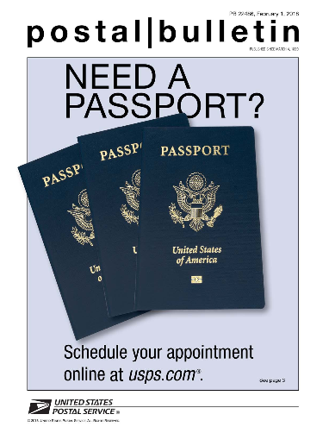
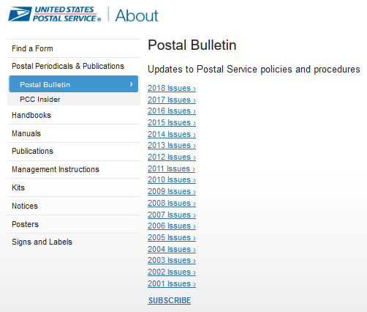
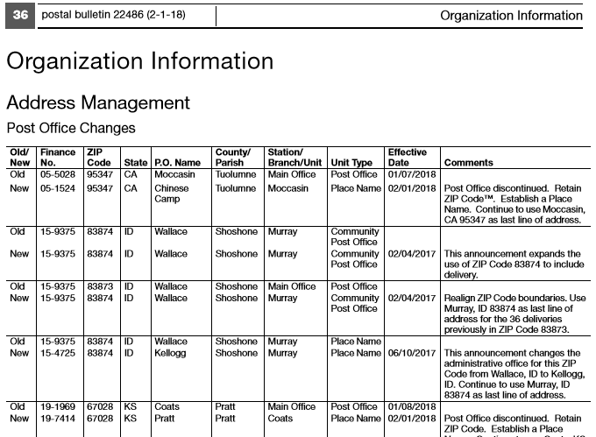
Postal Bulletin via PostalPro
Notes:
The Home Page provides a quick link to the fortnightly Postal Bulletin.
Information published as an advisory in the Federal Register appears in the Postal Bulletin when it is formally approved.
All rules based information appears in the Domestic Mail Manual (DMM).

Slide 36
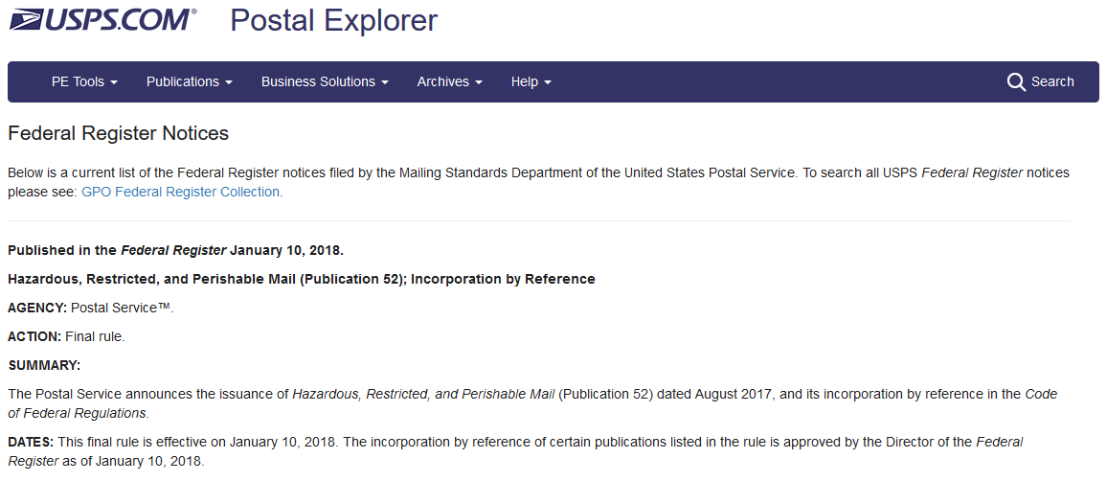
Notes:
The PostalPro resource page has a link to the USPS Federal Register Notice Summary, not the original Federal Registry page.

Slide 37
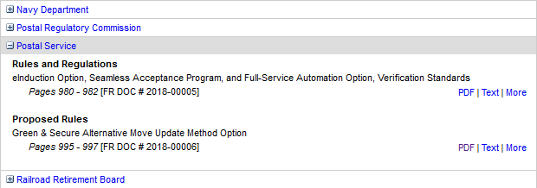
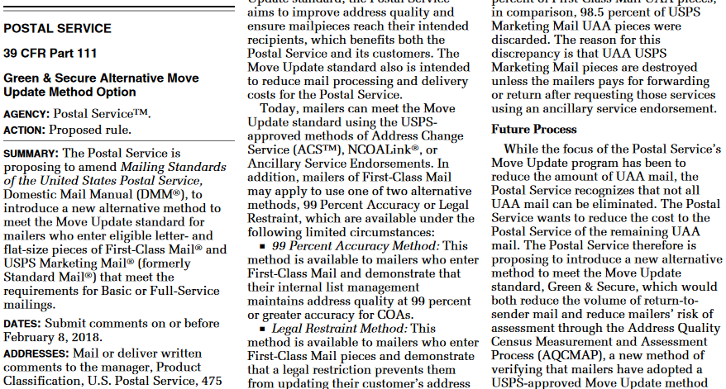
Notes:
The Federal Register USPS information. The notice(s) can appear each day.

Slide 38
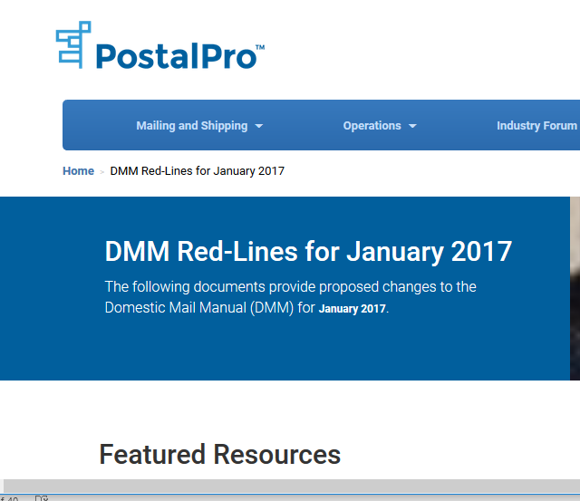
PostalPro When It Goes Wrong
Notes:
Currently, PostalExplorer is the best source for publication related information. PostalPro provides an out-dated example of the Domestic Mail Manual proposed Red-Line changes. The correct location is best found through PostalExplorer. The USPS HQ team has been advised of this connection failure.

Slide 39
PostalPro Feedback Requested
Available on the top and bottom of the main page.
Notes:
Please provide feedback to PostalPro at anytime and as often as necessary to promote changes. RIBBS is gone. PostalPro and its improvement are the result of all of us taking a turn at correction.

Slide 40
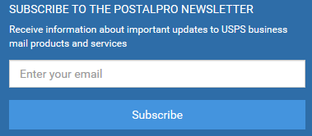
PostalPro Participation
Notes:
Consider subscribing to the PostalPro newsletter. This is available on the Home Page.

Slide 41
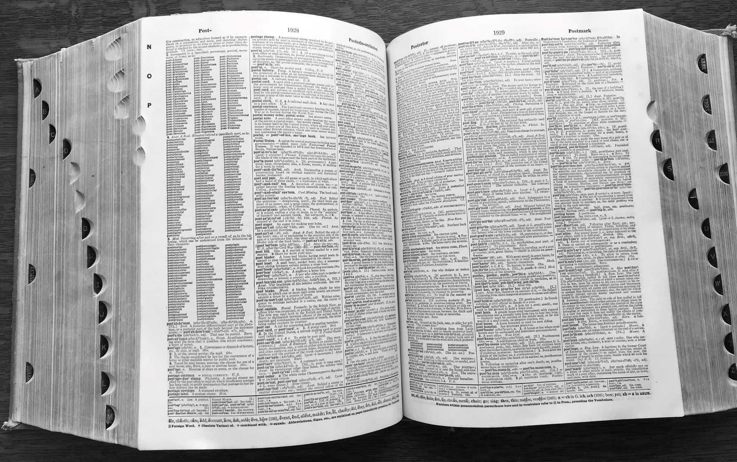
Questions?
Bonus Question
Slide Deck Basis Acknowledgement
Michael Filipski – HQ Business Mailer Support Analyst
michael.v.filipski@usps.gov
base60consulting@gmail.com
978.363.1810
Notes:
Many thanks to Headquarters specialist, Michael Filipski for the foundation slides.
If you have any questions or suggestions for improvement, please feel free to contact me directly.
Bonus Question – What is the missing quick link on the Home Page all of us should have readily available? The Domestic Mail Manual.

